Slide 1
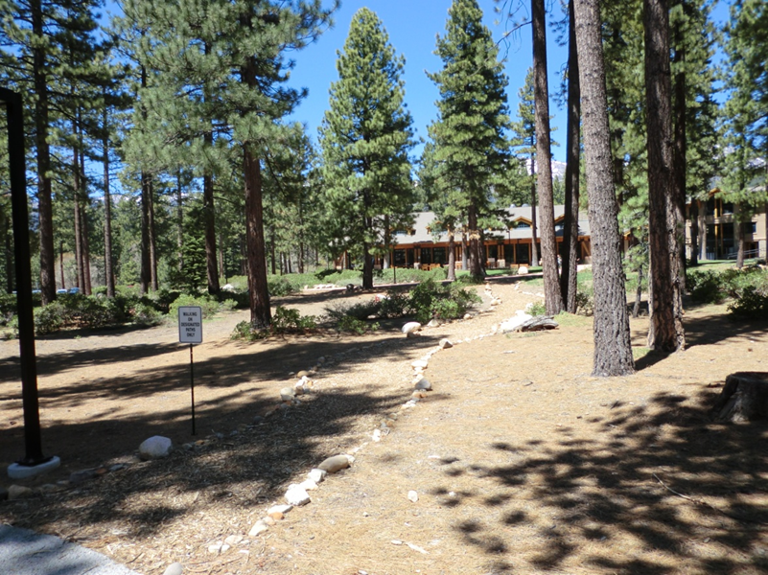
Washoe County Board of Adjustment
June 1, 2017
Administrative Permit Case Number WADMIN17-0004 Classical Tahoe

Slide 2
Case Description
For possible action, hearing, and discussion to approve an Administrative Permit and outdoor community event business license application, and associated license conditions for Classical Tahoe, an outdoor concert event to be held at the Sierra Nevada College in Incline Village, Nevada on July 28, 29, and 30, August 1, 4, 5, 8, 11 and 12, 2017. The proposed outdoor concerts will be held between the hours of 5:00 p.m. and 8:30 p.m. All proposed concerts will be unamplified classical music located within a portable tent erected on the College campus for the event. Primary participant and spectator parking will be within the College campus (APN: 127-040-10) with additional off-site (overflow) parking at the Incline Village General Improvement District (IVGID) Recreation Facility (APN: 127-040-07), if needed. Event organizers estimate that approximately 1,300 participants and spectators will take part in the event during any one three-day event period, with a maximum of 500 participants and spectators on any one day of the event. If approved, authorize the Director of the Planning and Development Division, Community Services Department to issue the outdoor community event business license when all pre-event conditions have been met.

Slide 3
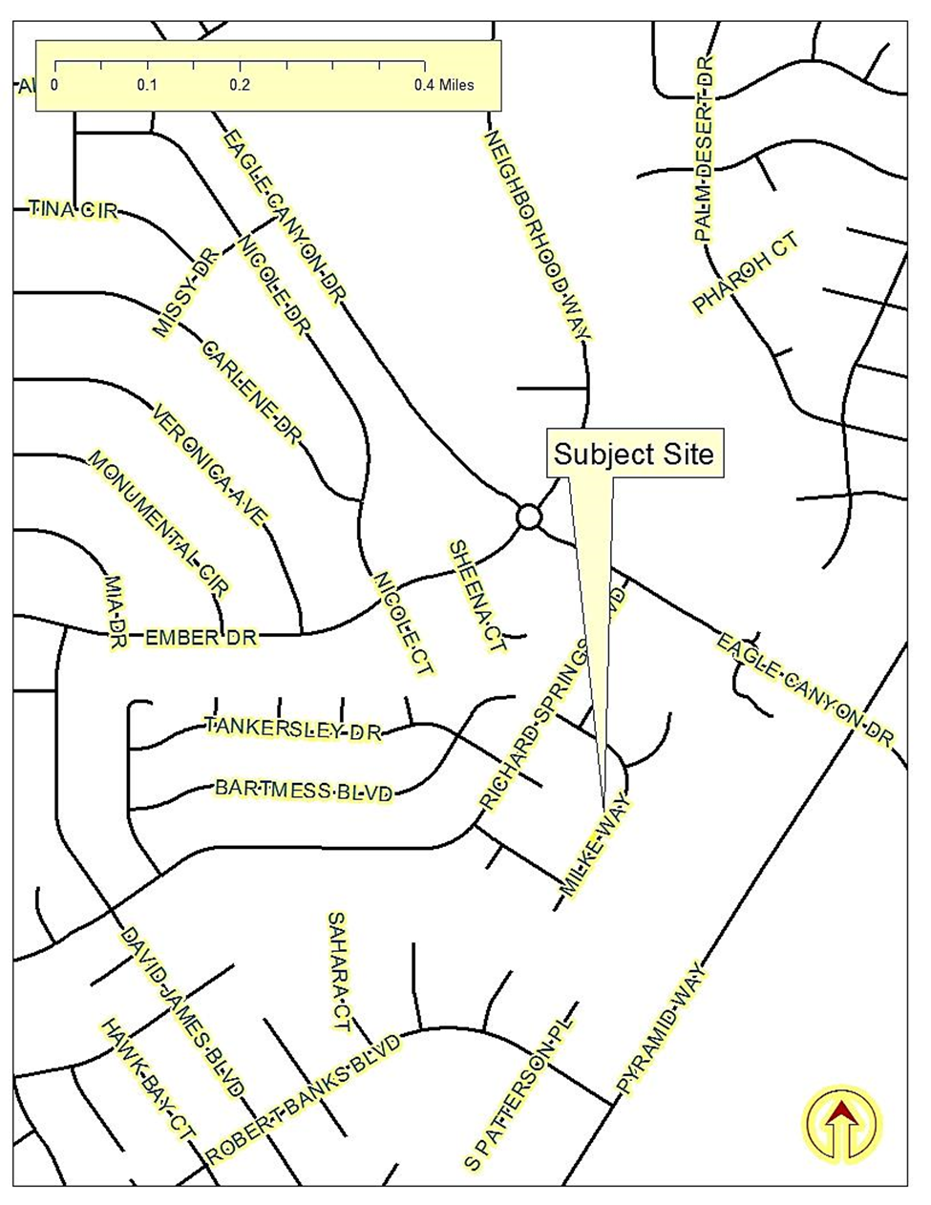
Vicinity Map

Slide 4
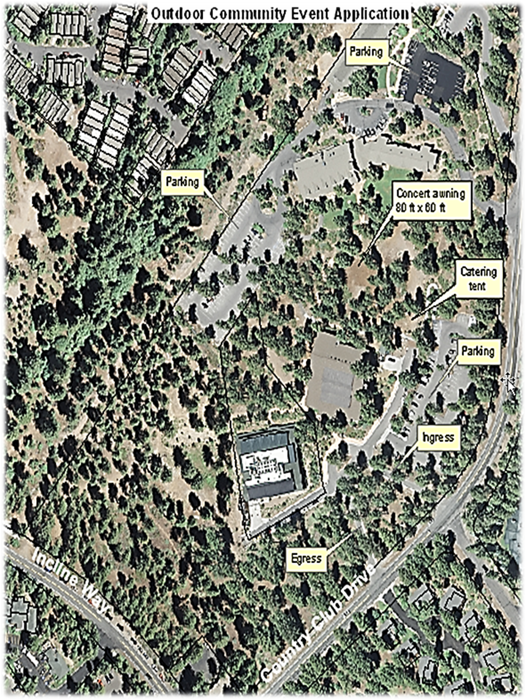
Site Plan

Slide 5
Background
Concerts: July 28, 29, and 30, August 1, 4, 5, 8, 11 and 12, 2017.
Between the hours of 5:00 p.m. and 8:30 p.m.
Unamplified classical music located within a portable tent erected on the College campus
Participant and spectator parking will be within the College campus with additional off-site (overflow) parking at the Incline Village General Improvement District (IVGID) Recreation Facility

Slide 6
Analysis
Parking, sanitation, food preparation, traffic have all been addressed by appropriate conditions of approval.
Substantially similar to previous-years events.

Slide 7
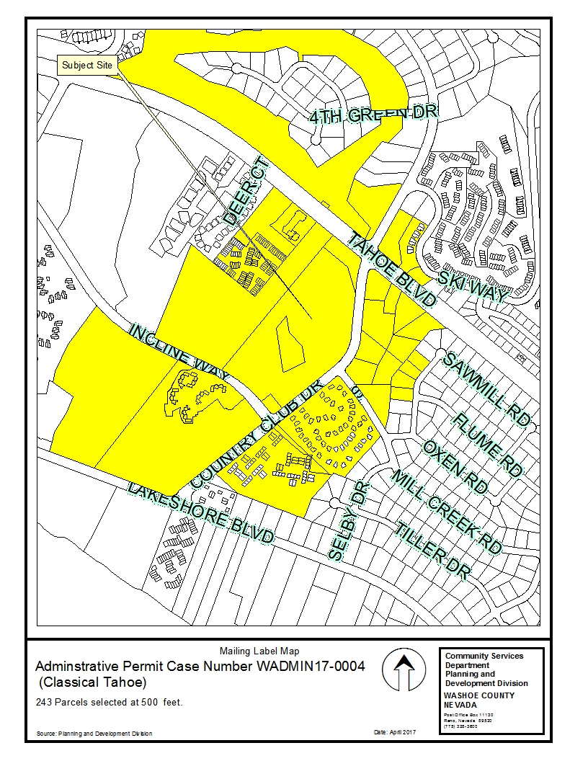
Public
Notice

Slide 8
Administrative Permit Findings

Slide 9
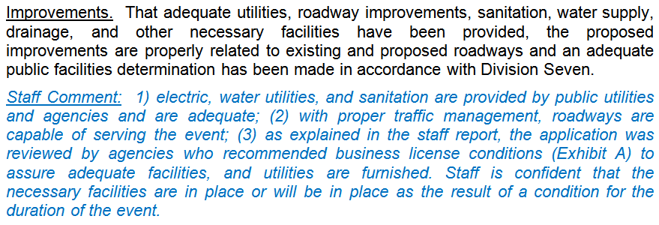
Administrative Permit Findings

Slide 10
Administrative Permit Findings

Slide 11
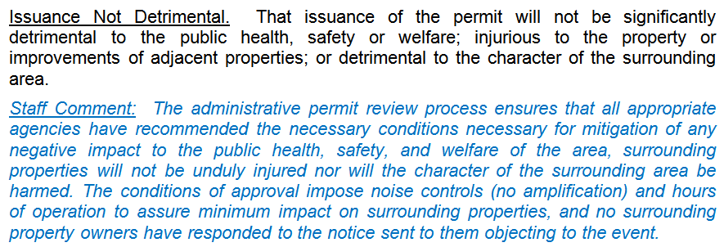
Administrative Permit Findings

Slide 12
Administrative Permit Findings

Slide 13
Recommendation
Those agencies which reviewed the application recommended conditions in support of approval of the project or provided no comments. Therefore, after a thorough analysis and review, Administrative Permit Case Number WADMIN17-0004 and the outdoor community event business license application is being recommended for approval with conditions.

Slide 14
Possible Motion
I move that, after giving reasoned consideration to the information contained in the staff report and information received during the public hearing, the Board of Adjustment approve Administrative Permit Case Number WADMIN17-0004 and the outdoor community event business license application for Classical Tahoe, with the business license conditions included at Exhibit A for this matter, having made all relevant findings in accordance with Washoe County Code Section 110.808.25. I further move to authorize the Director of the Planning and Development Division, Community Services Department to issue the outdoor community event business license when all pre-event conditions have been met.

Slide 15
Questions?

